Slide 1
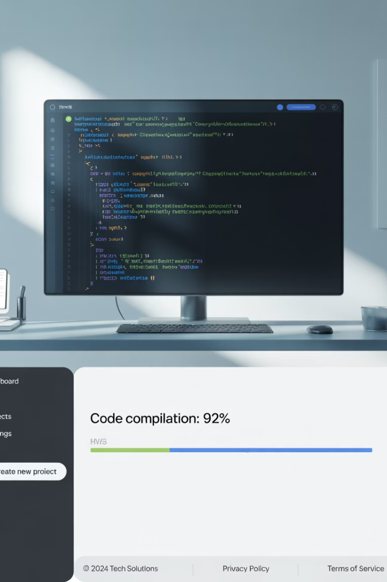
HTML & HTML5 Essentials
Welcome to HTML & HTML5 Essentials, your comprehensive guide to understanding the fundamental building blocks of the web. This presentation will take you through everything you need to know about HTML, from basic structure to semantic elements, helping you build well-structured, accessible web pages.
Whether you're a complete beginner or looking to refresh your knowledge, we'll cover all the essential tags, elements, and best practices that form the foundation of modern web development.
LW
by Liang Wang

Slide 2





Learning Objectives
Understand HTML Document Structure
Create the basic structure of an HTML5 document with proper syntax and organization
Master Essential HTML Tags
Use headings, paragraphs, lists, images, links, and tables effectively
Apply Semantic HTML5 Elements
Improve accessibility and structure with semantic tags
Implement Proper Linking
Differentiate between internal and external linking techniques

Slide 3
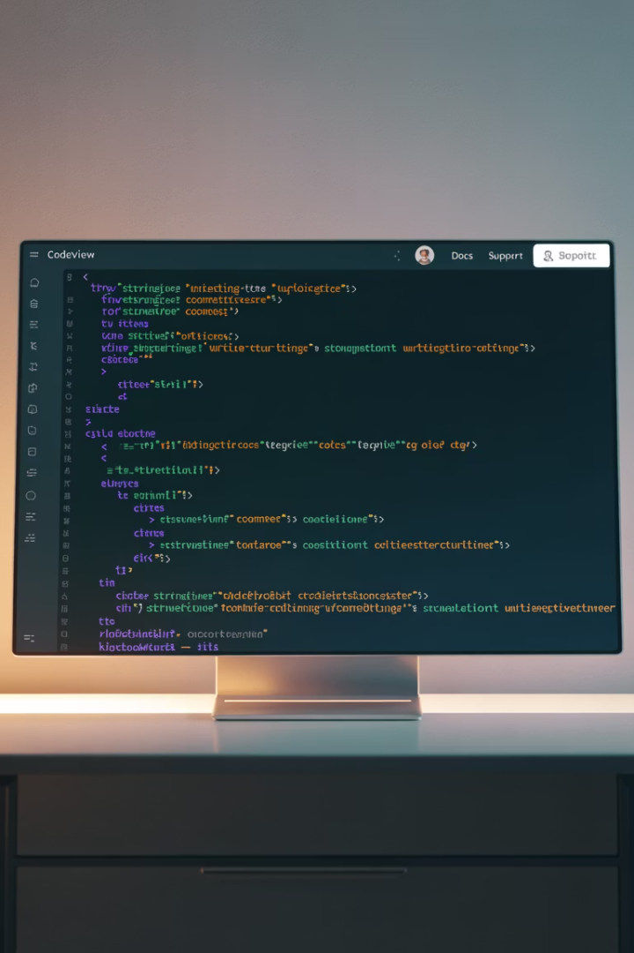
What is HTML?
Markup Language
Uses Tags
HTML stands for HyperText Markup Language. It is the standard markup language used to create and structure content on the web, not a programming language.
It uses tags (like <p>, <h1>, <img>, etc.) to tell the browser how to display content, defining the structure of web pages.
Foundation of Web
Every web page you view in a browser is built using HTML at its core, serving as the foundation for all web content.

Slide 4
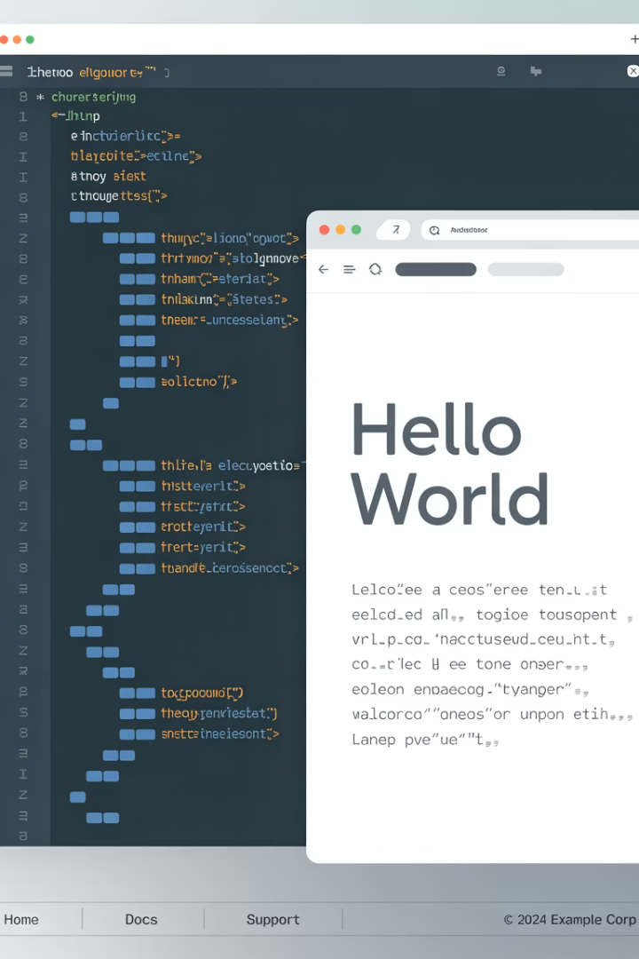



Basic HTML Example
<!DOCTYPE html> <html> <head> <title>My Website</title> </head> <body> <h1>Welcome!</h1> <p>This is a paragraph of text.</p> </body> </html>
Document Structure
The example shows the basic structure of an HTML document with head and body sections.
Content Elements
Contains a heading (h1) and paragraph (p) to display visible content on the page.
Browser Rendering
The browser interprets these tags to display a formatted webpage with proper structure.

Slide 5
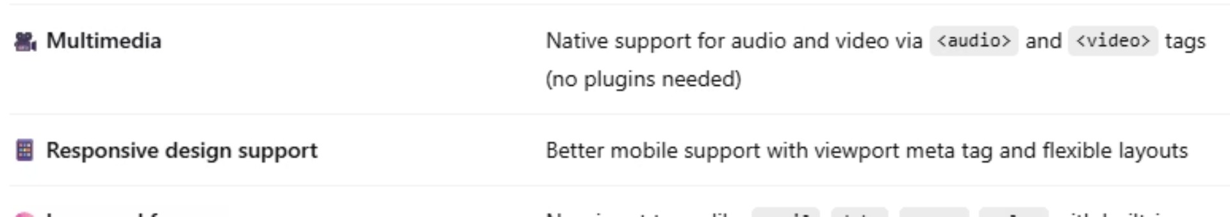




What is HTML5?
HTML5 is the latest version of HTML, released as a major revision by the W3C in 2014. It introduced new elements, attributes, and APIs to modernize web development and support richer user experiences.
Rich Media Support
Mobile-Friendly
Improved Accessibility
Local Storage
Native audio and video playback without plugins
Better support for responsive design and mobile devices
Semantic elements for better screen reader support
Client-side data storage capabilities

Slide 6
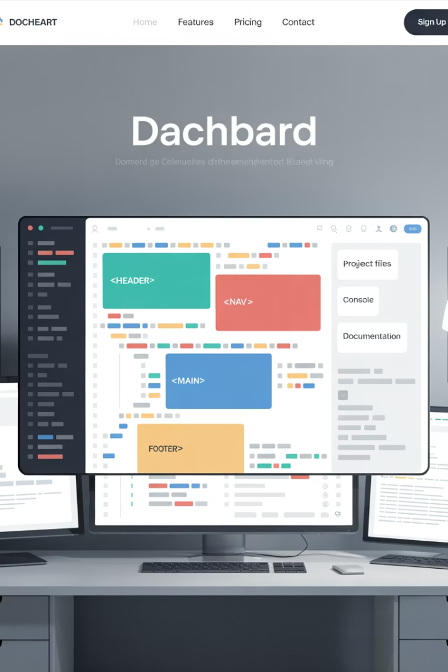
Semantic HTML5 Example
<!DOCTYPE html> <html> <head> <meta charset="UTF-8" /> <title>HTML5 Example</title> </head> <body> <header> <h1>My Blog</h1> </header> <nav> <a href="index.html">Home</a> | <a href="about.html">About</a> </nav> <main> <article> <h2>Why I Love Coding</h2> <p>Coding is both fun and creative...</p> </article> </main> <footer> <p>© 2025 My Blog</p> </footer> </body> </html>
This example demonstrates a well-structured HTML5 document using semantic elements like <header>, <nav>, <main>, <article>, and <footer> to clearly define different sections of the page, improving both readability and accessibility.

Slide 7
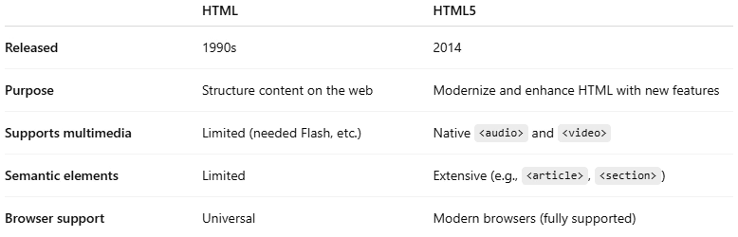
HTML vs HTML5: Key Differences
HTML
HTML5
Uses generic div tags for structure
Semantic elements (header, nav, footer)
Requires plugins for media
Native audio/video support
Limited form input types
Rich form elements (date, email, range)
JavaScript needed for drawing
Canvas element for drawing
No native support for mobile
Mobile-friendly features

Slide 8
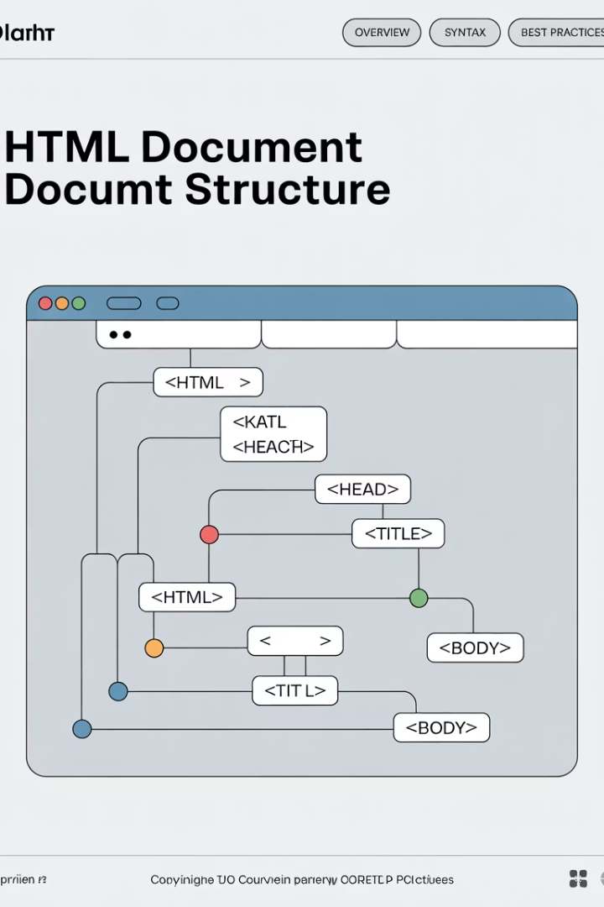
Structure of an HTML Page
<!DOCTYPE html> <html lang="en"> <head> <meta charset="UTF-8" /> <meta name="viewport" content="width=device-width, initial-scale=1.0" /> <title>My First Web Page</title> </head> <body> <!-- Content goes here --> </body> </html>
Document Type Declaration
<!DOCTYPE html> declares this is an HTML5 document, telling browsers how to interpret the code.
HTML Root Element
<html lang="en"> is the root element containing all other elements, with language specified as English.
Head Section
Contains metadata, character encoding, viewport settings, and the page title that appears in browser tabs.
Body Section
Contains all visible content that users will see and interact with on the webpage.

Slide 9





Understanding the HTML Language Attribute
Language Specification
Search Engine Optimization
The lang="en" attribute in the <html> tag specifies that the document's content is in English.
Helps search engines properly index your content based on language, improving search results.
Accessibility Benefits
Translation Tools
Enables screen readers to use the correct pronunciation and accent when reading the content aloud.
Assists translation tools in identifying the original language of the document for accurate translations.

Slide 10
Meta Tags Explained
Character Encoding
Viewport Settings
<meta charset="UTF-8" />
<meta name="viewport" content="width=device-width, initial-scale=1.0" />
Defines the character encoding used in the page
UTF-8 is the most widely used character encoding
Controls how a page displays on mobile devices
Ensures proper display of special characters
width=device-width matches page width to screen width
Omitting may cause incorrect character display
initial-scale=1.0 sets initial zoom level to 100%
Essential for responsive web design

Slide 11
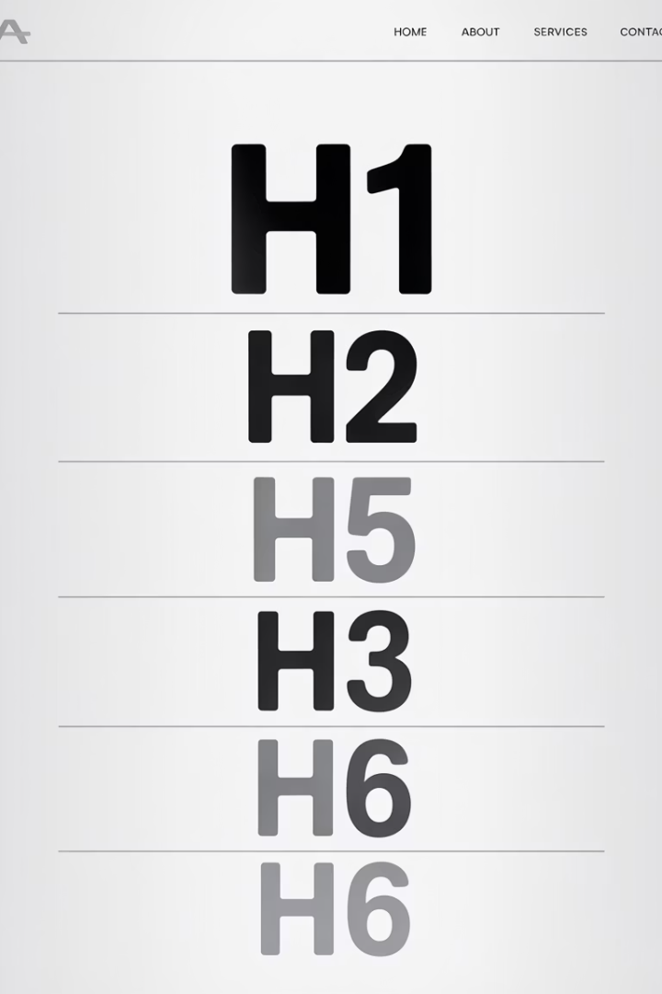
Heading Tags in HTML
HTML heading tags define headings and subheadings in a web page. They help structure content, improve accessibility, and optimize for search engines (SEO).
Tag
Description
<h1>
Main heading (most important)
<h2>
Subheading
<h3>
Sub-subheading
<h4>
Smaller heading
<h5>
Even smaller heading
<h6>
Smallest heading (least important)

Slide 12








Heading Tags Hierarchy
<h1> Main Title
Like a book title
<h2> Section Heading
Like a chapter title
<h3> Subsection
Like a section within a chapter
<h4>-<h6> Minor Headings
Increasingly specific subtopics
Think of heading tags as creating a document outline, similar to a book's structure. The <h1> tag represents the main title, while subsequent heading levels create a hierarchical structure that helps organize content logically for both users and search engines.

Slide 13
Heading Tags Example
Think of heading tags like a document outline:
<!DOCTYPE html> <html lang="en"> <head> <meta charset="UTF-8" /> <meta name="viewport" content="width=device-width, initial-scale=1.0" /> <title>My First Web Page</title> </head> <body> <h1>Welcome to My Website</h1>
<h2>About Me</h2>
<h3>My Hobbies</h3>
<h4>Photography</h4>
<h5>Camera Settings</h5>
<h6>ISO Tips</h6> </body> </html>
h1 is the title of a book
h2 is a chapter
h3 is a section within that chapter
And so on...
Welcome to My Website
About Me
My Hobbies
Photography
Camera Settings
ISO Tips
ISO Tips

Slide 14

Paragraph Tag
Basic Structure
Block-Level Element
The <p> tag in HTML is used to define a paragraph of text. It's one of the most commonly used elements in web content.
The browser automatically adds space before and after each <p> tag (called block-level spacing), creating visual separation between paragraphs.
Content Organization
Each <p> represents a separate block of content, helping organize text into readable sections for better user experience.
<p>HTML stands for HyperText Markup Language.</p> <p>It is used to structure content on the web.</p>

Slide 15
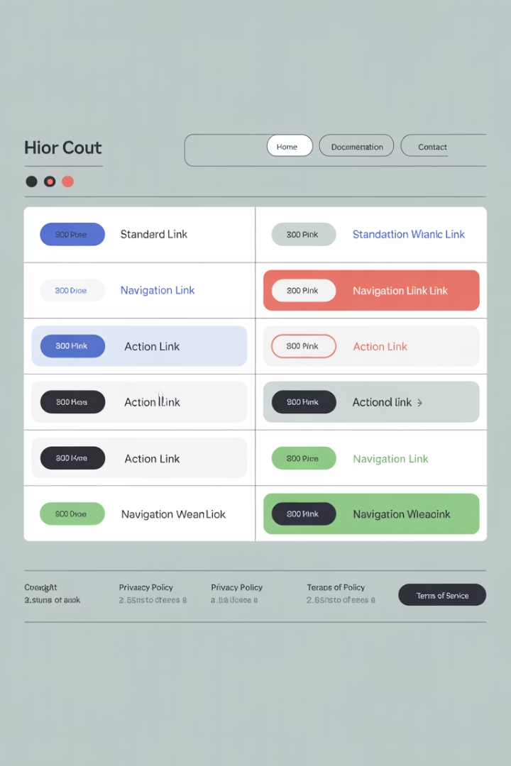
Anchor Tag for Links
The <a> (anchor) tag creates clickable links that take users to another page, section, or file. It's one of the most important elements in HTML, enabling the "hypertext" part of HTML.
Attribute
Purpose
href
The URL or path to link to
target="_blank"
Opens the link in a new tab
title
Tooltip shown on hover
download
Prompts file download

Slide 16
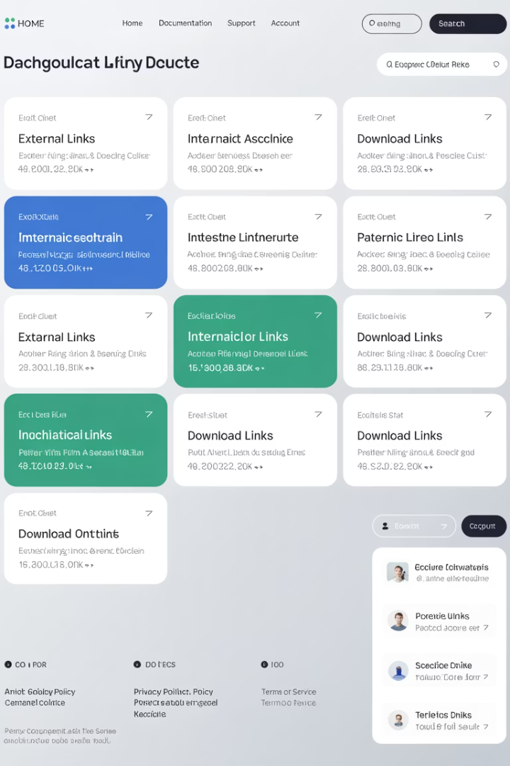




Types of Links
External Link
Internal Link
Jump to Section
<a href="https://www.wikipedia.org" target="_blank">Wikipedia</a>
<a href="about.html">About Us</a>
<a href="#contact">Go to Contact</a>
Links to other pages within the same website
<h2 id="contact">Contact Us</h2>
Links to specific sections within the same page
Links to other websites, often opened in new tabs
Download Link
<a href="flathouse.jpg" download>Download</a>
Prompts the user to download a file

Slide 17
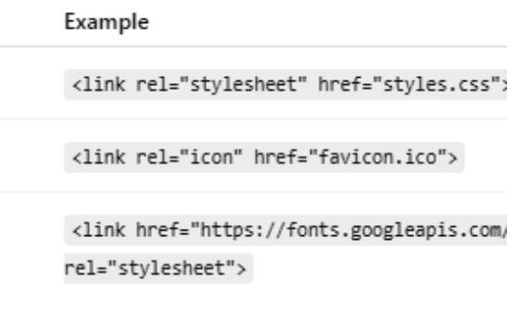
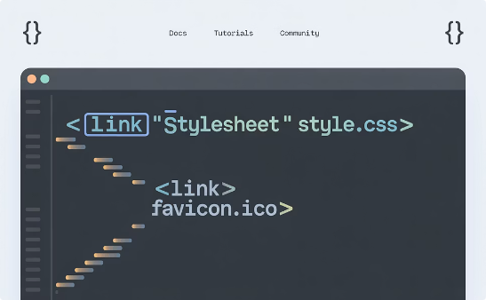
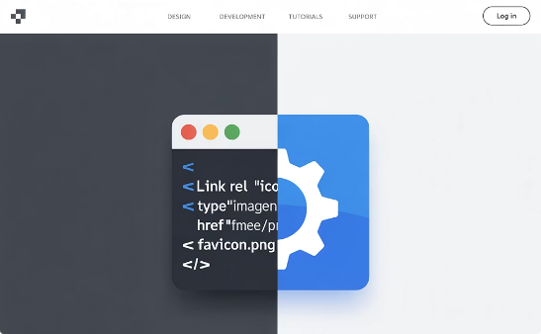
Link Element in Head
The <link> element is used in the <head> of an HTML document to link external resources like CSS files or icons. Unlike the <a> tag, it doesn't create visible links but establishes connections to external resources.
Common Link Element Uses
Linking CSS Stylesheets
Adding Favicons
The <link> element connects stylesheets, icons, and other resources to your HTML document, enhancing functionality and appearance without creating visible links.
<link rel="stylesheet" href="styles.css">
<link rel="icon" href="favicon.ico">
This connects external CSS files to style your HTML document, separating content from presentation.
This adds the small icon that appears in browser tabs and bookmarks, enhancing brand identity.

Slide 18
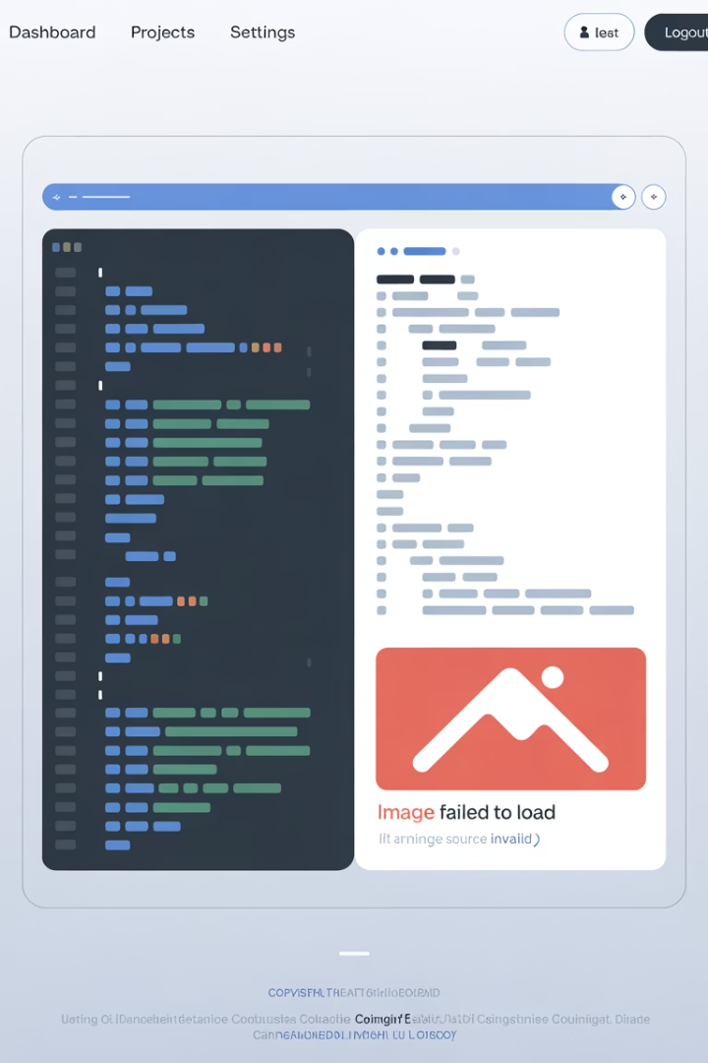
Image Tag
The <img> element in HTML is used to embed images into a web page. It is a self-closing (void) tag, meaning it doesn't have a closing tag like </img>.
Attribute
Purpose
Example
src
Specifies the path or URL of the image file
src="images/photo.jpg"
alt
Alternative text shown if image can't load
alt="A smiling dog"
width
Sets the width (in pixels or percent)
width="300"
height
Sets the height (in pixels or percent)
height="200"

Slide 19
Image Tag Example
Common Mistakes to Avoid
<img src="images/cat.png" alt="A cute gray cat" width="300" height="200" />
Forgetting the alt attribute, which is essential for accessibility
Using broken src paths, resulting in images that won't display
Using <img> without defining size, which can break layouts as images load
Using very large images without optimization, slowing page load times
This code will display an image called cat.png that is 300 pixels wide and 200 pixels tall, with alt text for screen readers or if the image fails to load.

Slide 20



Unordered Lists
Syntax
Output
HTML
<ul> <li>HTML</li> <li>CSS</li> <li>JavaScript</li> </ul>
CSS
JavaScript
Unordered lists display items with bullet points. Use them when the order of items doesn't matter, such as a shopping list or skills list.
Structure
Styling
Nesting
The <ul> element contains multiple <li> (list item) elements
By default, browsers display bullet points, but these can be customized with CSS
Lists can be nested inside other lists to create hierarchical structures

Slide 21



Ordered Lists
Syntax
Output
Preheat oven
<ol> <li>Preheat oven</li> <li>Mix ingredients</li> <li>Bake for 30 minutes</li> </ol>
Mix ingredients
Bake for 30 minutes
Ordered lists display items with numbers (or letters/roman numerals if styled). Use them when the order matters, such as instructions, steps, or rankings.
Automatic Numbering
Type Attribute
Start Attribute
The browser automatically numbers the items sequentially
Can be set to display numbers (1, 2, 3), letters (a, b, c), or Roman numerals (i, ii, iii)
Can specify a starting number other than 1

Slide 22



Description Lists
Syntax
Output
HTML A markup language for web pages.
<dl> <dt>HTML</dt> <dd>A markup language for web pages.</dd> <dt>CSS</dt> <dd>A style sheet language for describing presentation.</dd> </dl>
CSS A style sheet language for describing presentation.
Description lists define terms and their descriptions, making them useful for glossaries, dictionaries, or FAQs.
Term Element
Description Element
Multiple Descriptions
<dt> (definition term) contains the term being defined
<dd> (definition description) contains the explanation of the term
A single term can have multiple description elements

Slide 23
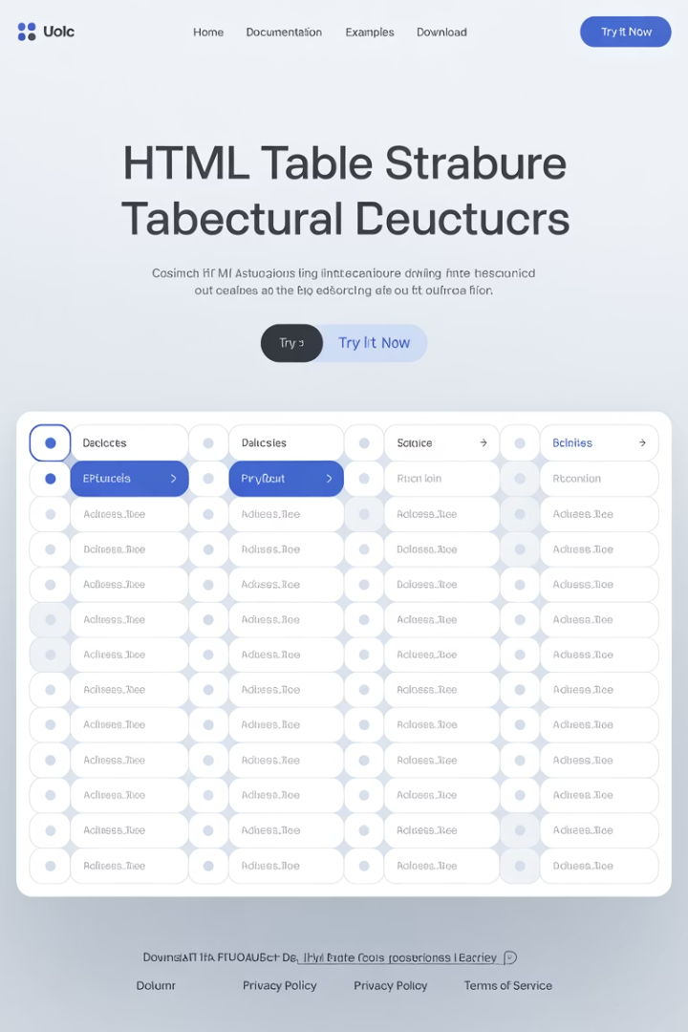
Table Element
The <table> element in HTML is used to display data in rows and columns, just like a spreadsheet. It allows you to organize information clearly, such as schedules, pricing tables, or comparisons.
Tag
Meaning
Purpose
<table>
Table
Container for the whole table
<tr>
Table Row
Defines a row of cells
<th>
Table Header
Defines a header cell (bold, centered)
<td>
Table Data
Defines a data cell (standard cell)
<caption>
Caption
Optional title for the table

Slide 24
Table Example
Best Practices
<table> <caption>Web Development Courses</caption> <tr> <th>Course</th> <th>Duration</th> </tr> <tr> <td>HTML</td> <td>3 weeks</td> </tr> <tr> <td>CSS</td> <td>2 weeks</td> </tr> </table>
Always include a header row using <th> for accessibility and clarity
Use tables for tabular data only, not for layout (use CSS for layout)
Add a <caption> if needed to provide context for the table
Consider using <thead>, <tbody>, and <tfoot> for complex tables
Course
Duration
HTML
3 weeks
CSS
2 weeks

Slide 25
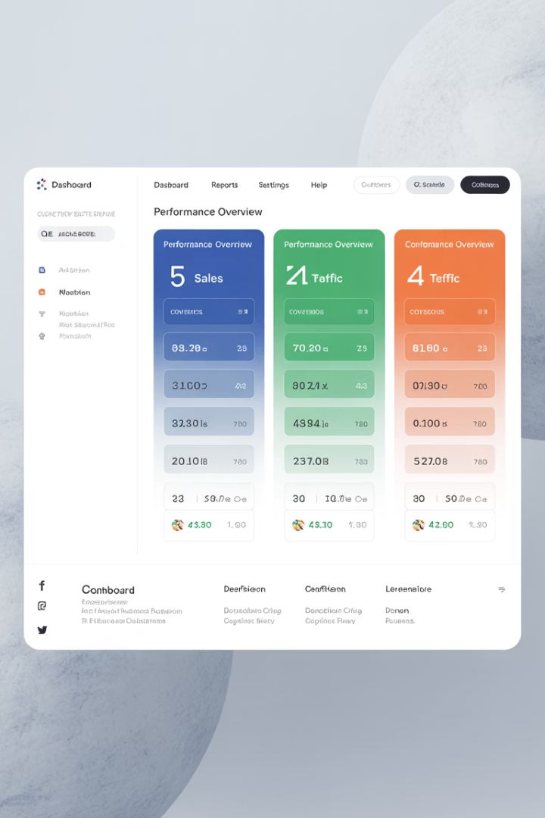
Div Element
Generic Container
Organizational Tool
The <div> tag in HTML stands for "division" and is a block-level container used to group other HTML elements together.
Used to organize and group content, apply CSS styling or JavaScript functionality to a section, and create layout structures (e.g., header, sidebar, footer).
No Semantic Meaning
<div> has no semantic meaning — it says nothing about the content. For meaningful structure, prefer semantic HTML5 tags when possible.
<div> <h2>Welcome</h2> <p>This is a welcome message inside a div.</p> </div>

Slide 26








Semantic HTML5 Elements
Semantic HTML5 elements are tags that clearly describe their meaning and purpose in the structure of a web page, making the content more readable for both humans and machines (like screen readers and search engines).
Improved Accessibility
Better SEO
Helps users with assistive technologies navigate content more effectively
Helps search engines understand page structure and content relevance
Clear Structure
Cleaner Code
Defines content roles and relationships more explicitly
Makes HTML more readable and maintainable for developers

Slide 27
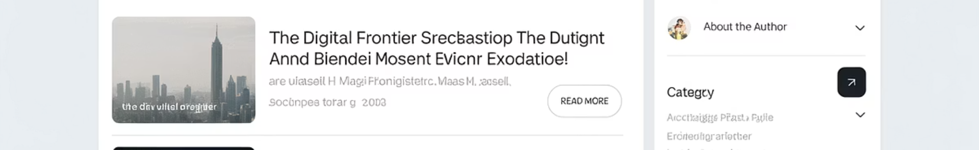
Common Semantic HTML5 Elements
Element
Purpose
<header>
Introductory content or page heading (often contains logo, title, nav)
<nav>
Navigation links (menus, tables of contents)
<main>
Main content unique to the page
<section>
Thematic grouping of related content (like chapters or tabs)
<article>
Self-contained content (like a blog post or news article)
<aside>
Sidebar or tangential content (like tips or ads)
<footer>
Footer content (like copyright, links, contact)

Slide 28
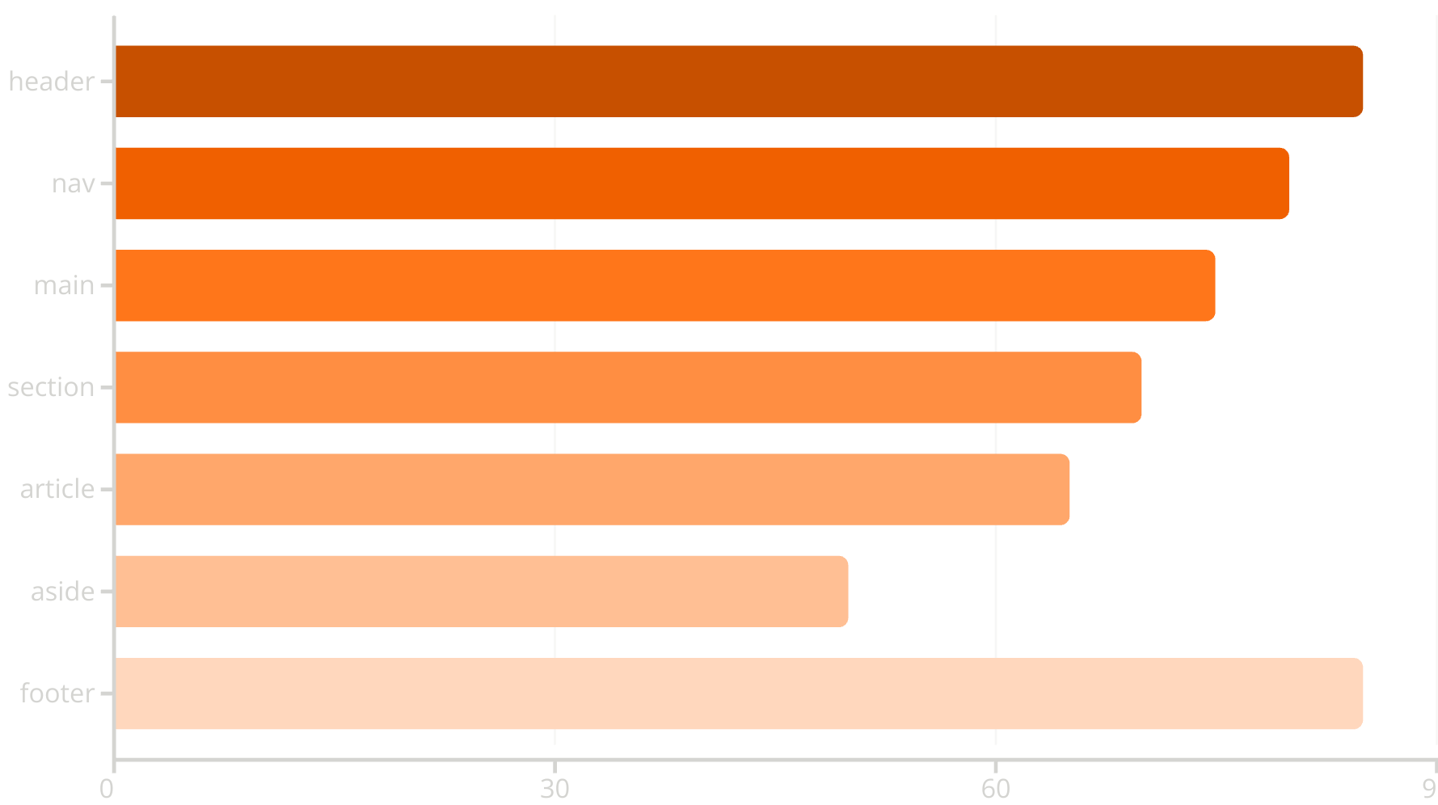
Common Semantic Elements
This chart shows the relative usage frequency of common semantic HTML5 elements in modern web development. Header, nav, and footer are the most widely adopted.

Slide 29





More Semantic HTML5 Elements
<figure> & <figcaption>
<mark>
<time>
<details> & <summary>
Highlights or emphasizes text, like a highlighter pen on paper
Represents dates/times for events or logs, helping machines parse temporal data
Groups media content with a caption, providing context for images, diagrams, or code snippets
Creates expandable/collapsible content sections for progressive disclosure

Slide 30

Semantic HTML5 Example
<main> <header> <h1>My Travel Blog</h1> <nav> <a href="index.html">Home</a> <a href="about.html">About</a> </nav> </header> <article> <h2>Exploring New Zealand</h2> <p>I visited the beautiful South Island...</p> </article> <aside> <p>Travel Tip: Bring waterproof gear!</p> </aside> <footer> <p>© 2025 My Travel Blog</p> </footer> </main>

Slide 31
Semantic vs. Non-Semantic Elements
Semantic Elements
Non-Semantic Elements
<header>
<div>
<nav>
<span>
<main>
Generic containers that tell nothing about their content
<article>
Use semantic elements whenever possible, and reserve non-semantic elements for when no appropriate semantic element exists
<section>
<aside>
<footer>
<figure>
<time>
Clearly describe their purpose and the type of content they contain

Slide 32



Summary: HTML & HTML5 Essentials
Document Structure
Master the basic HTML document structure with proper DOCTYPE, head, and body sections
Essential Tags
Use headings, paragraphs, lists, images, links, and tables effectively
Semantic Elements
Implement semantic HTML5 elements for better accessibility and SEO
Best Practices
4
Follow accessibility guidelines and proper element usage
You now have the essential knowledge to create well-structured, accessible web pages using HTML and HTML5. Remember that good HTML forms the foundation of any web project, and proper semantic structure benefits both users and search engines. Continue practicing these concepts to build your skills and create more complex web pages.

